Slide 1

YOLOWELLNESS: FOOD DELIVERY
By Poorva Sandhiya 2124207, Inbha 2123925, Jonathan 2020709, Caelan 2103103
HEALTHY
FOOD DELIVERY
WEBSITE

Slide 2
Features Used:
Home Page - logo, contact, search, faqs, services, login, sign-in etc.
Footer Page
About us
Consistent branding across all pages
Project Members Portfolio
Use of cookies, session
Google Map Direction
Embedded video
Quick Internal Search (Use of SQL)
Contact us or feedback from user stored to SQL database
Management of data (CRUD) stored to SQL database Create and Read Only
Discussion Forum, Comments
Payment System Using PayPal Sandbox
Use of Bootstrap framework

Slide 3
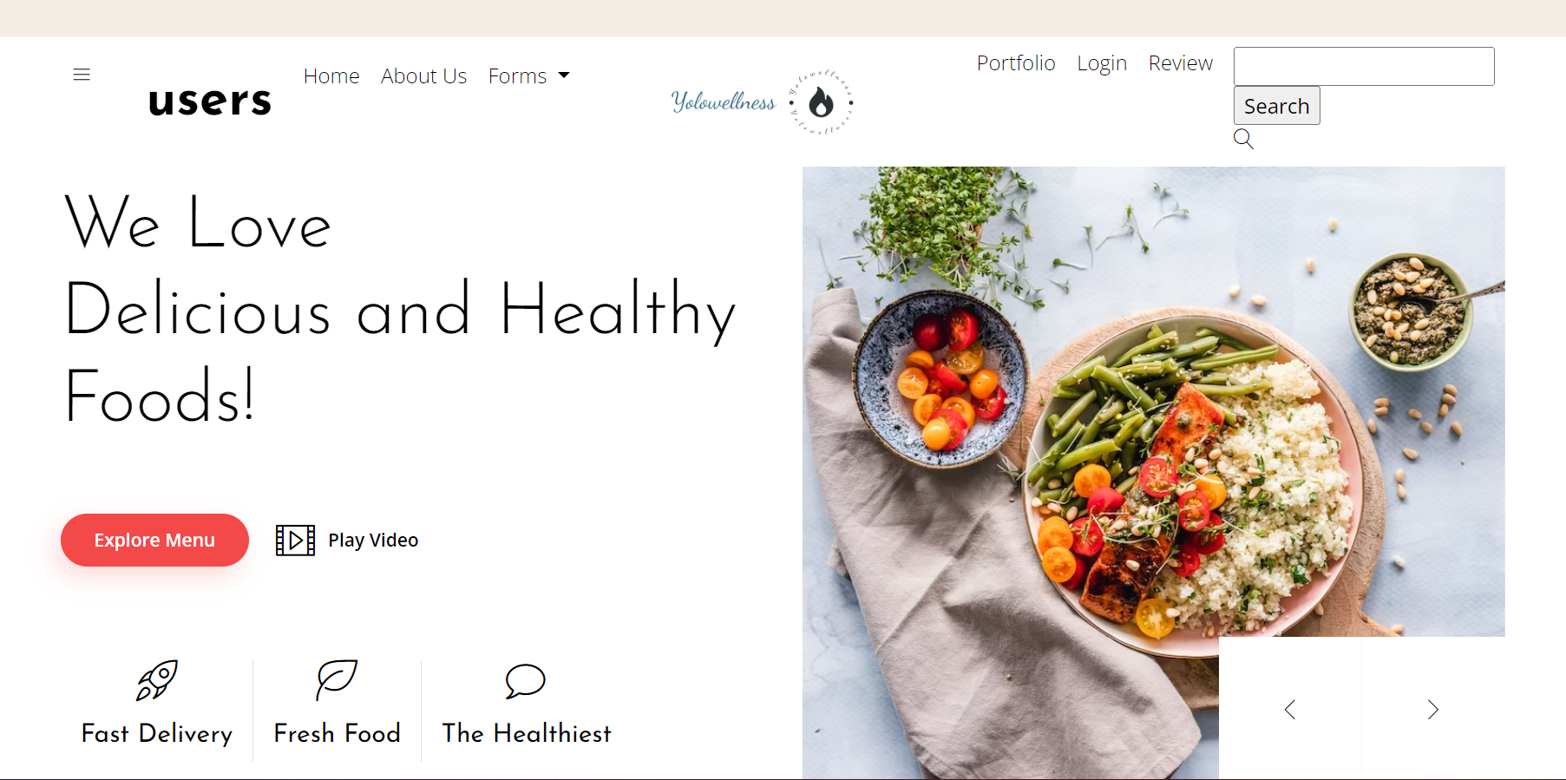
HOMEPAGE
Logo
Other Pages
Search bar
Our Pledge
Menu
Images
Embedded Video
Professions
Scroller

Slide 4

VIDEO

Slide 5
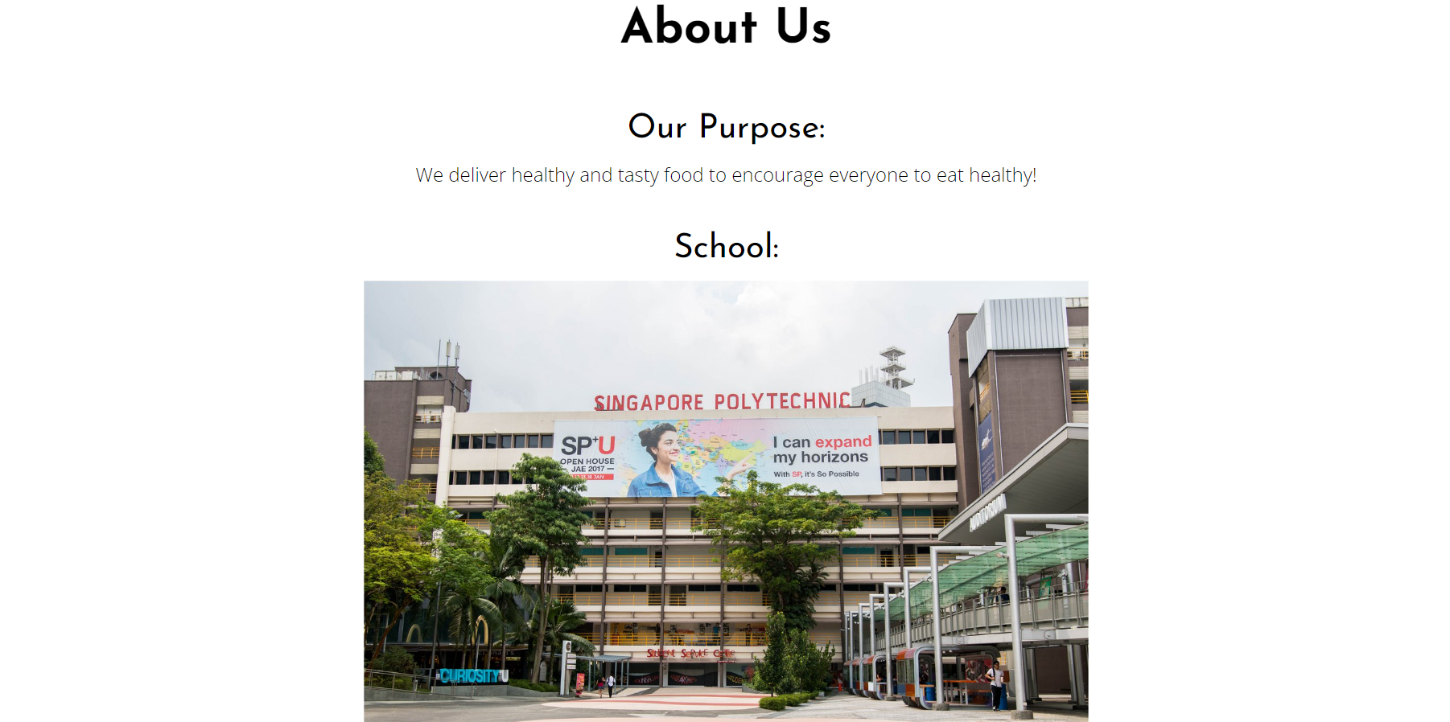
ABOUT US
Image

Slide 6
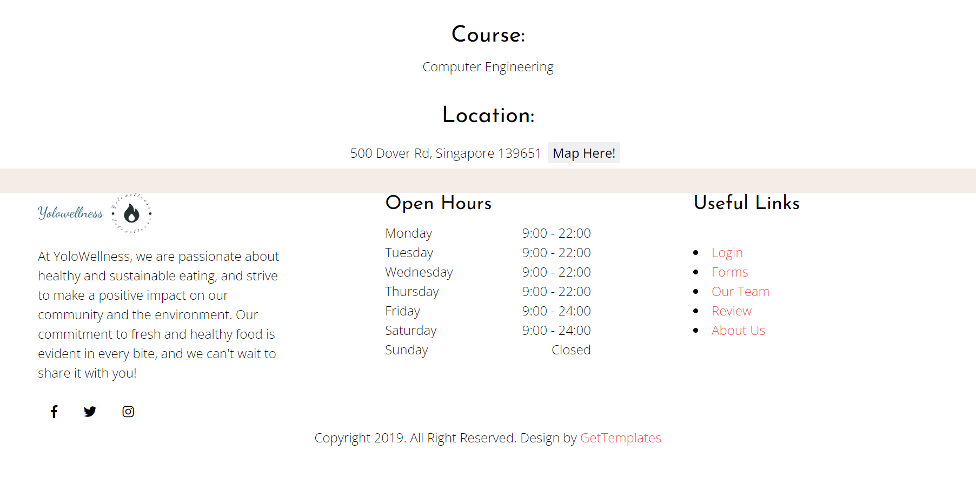
FOOTER
Google Map
Opening hours
Other Pages
More Info

Slide 7
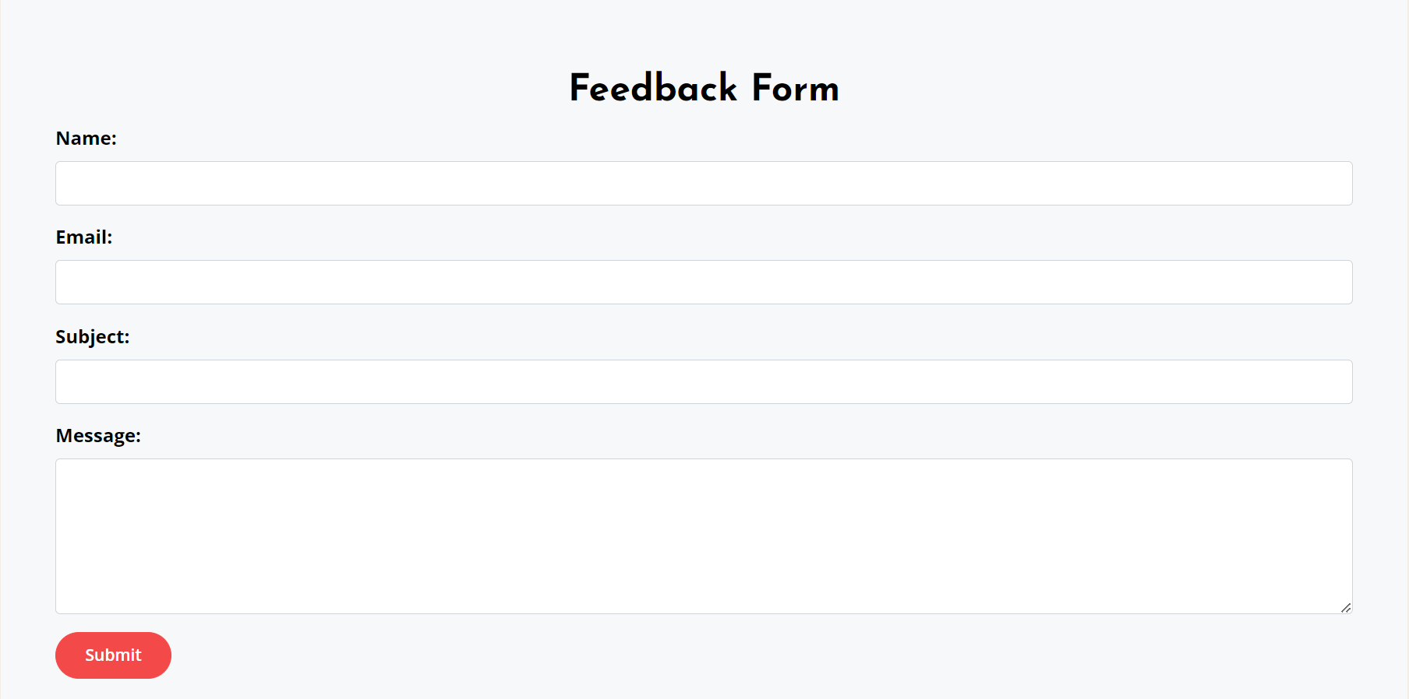
FEEDBACK FORM
Textboxes
Submit

Slide 8
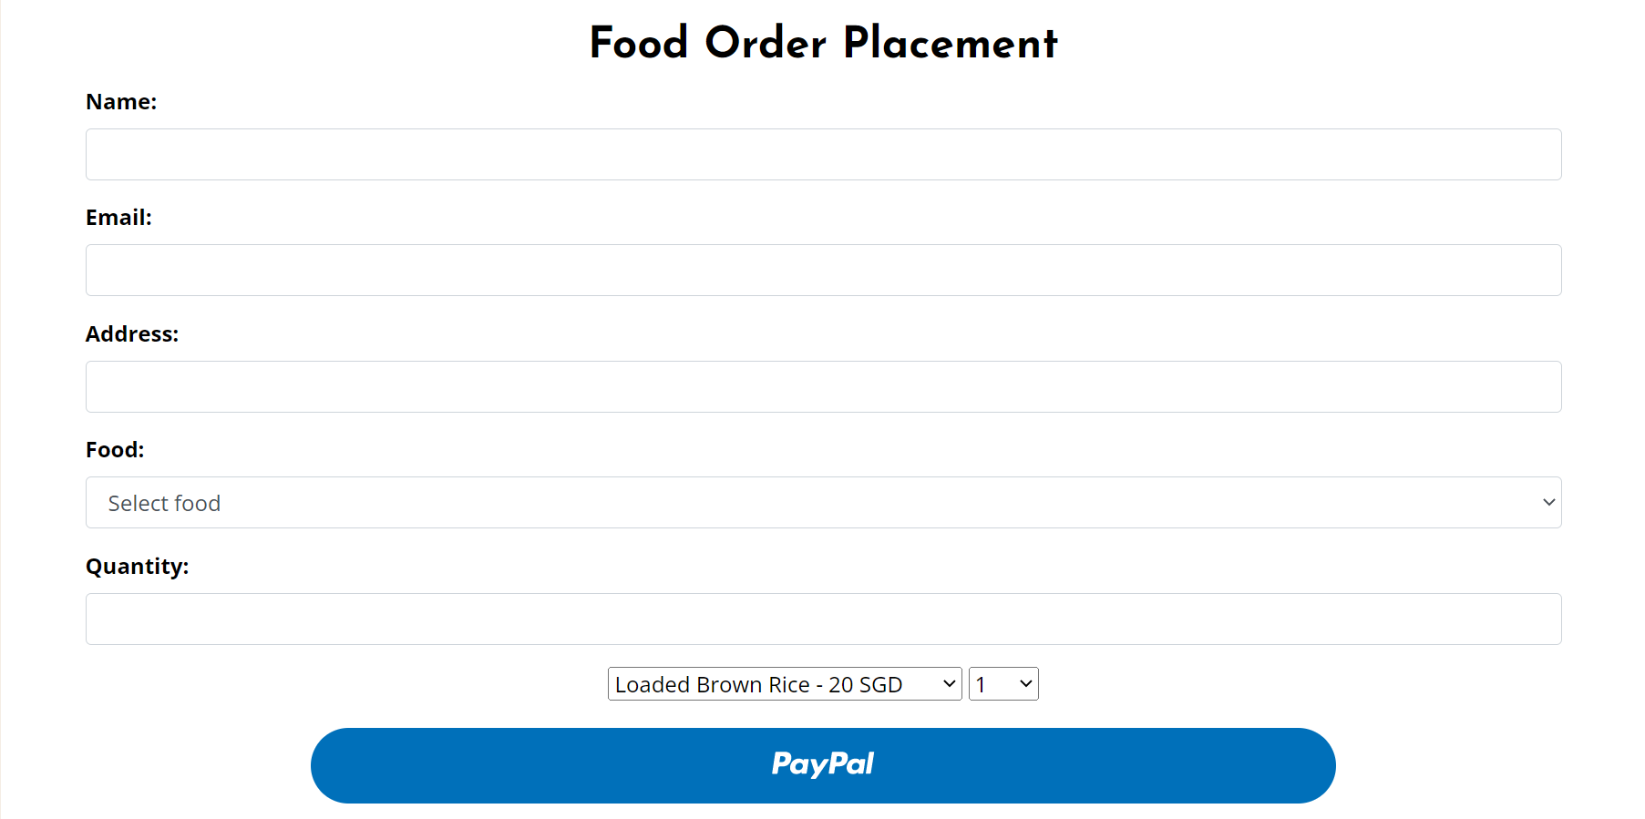
FOOD ORDER FORM
Textboxes
Payment system

Slide 9
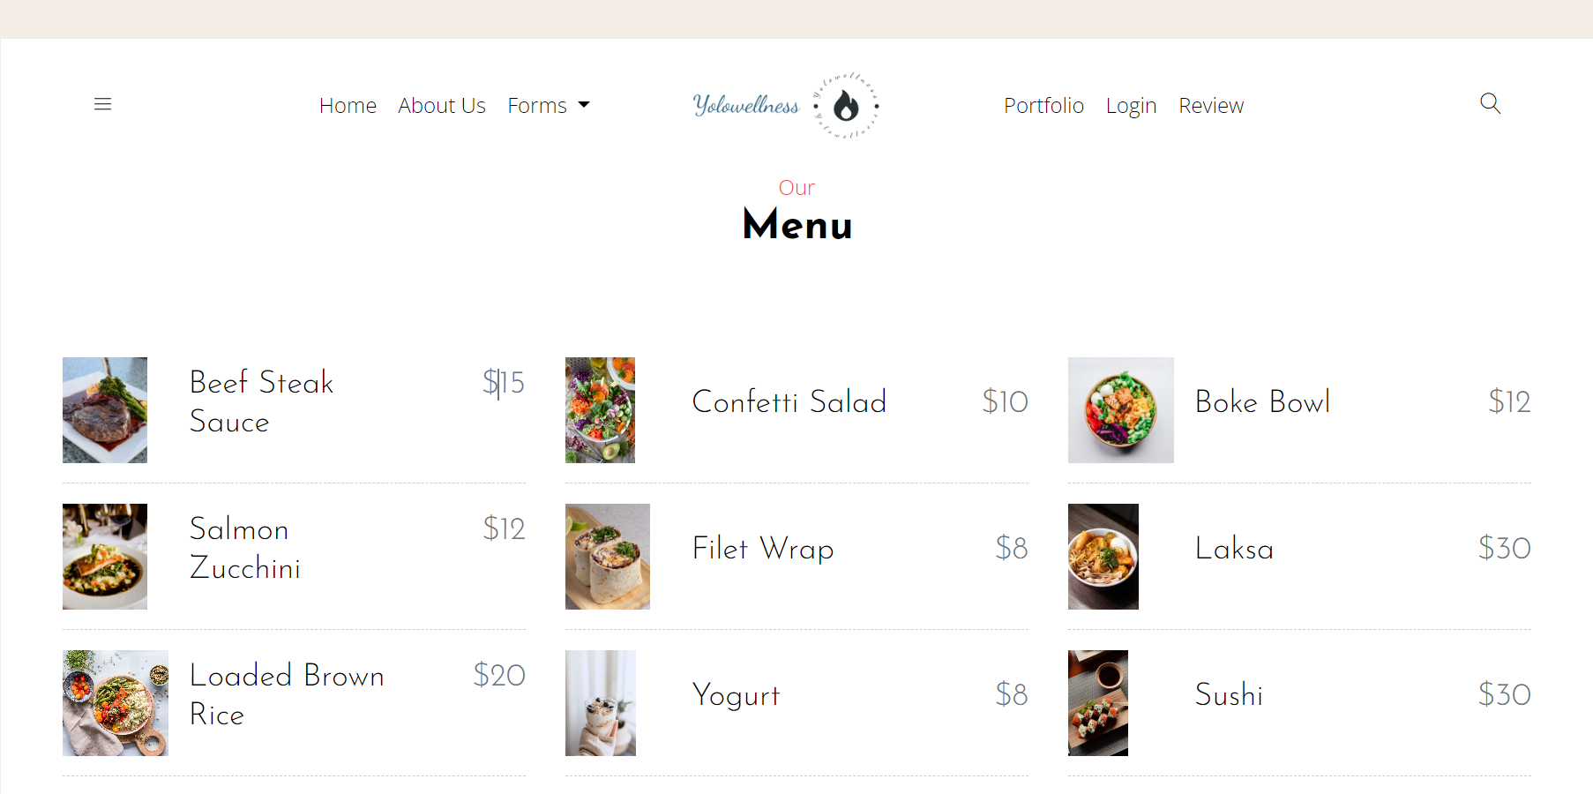
MENU
Items

Slide 10
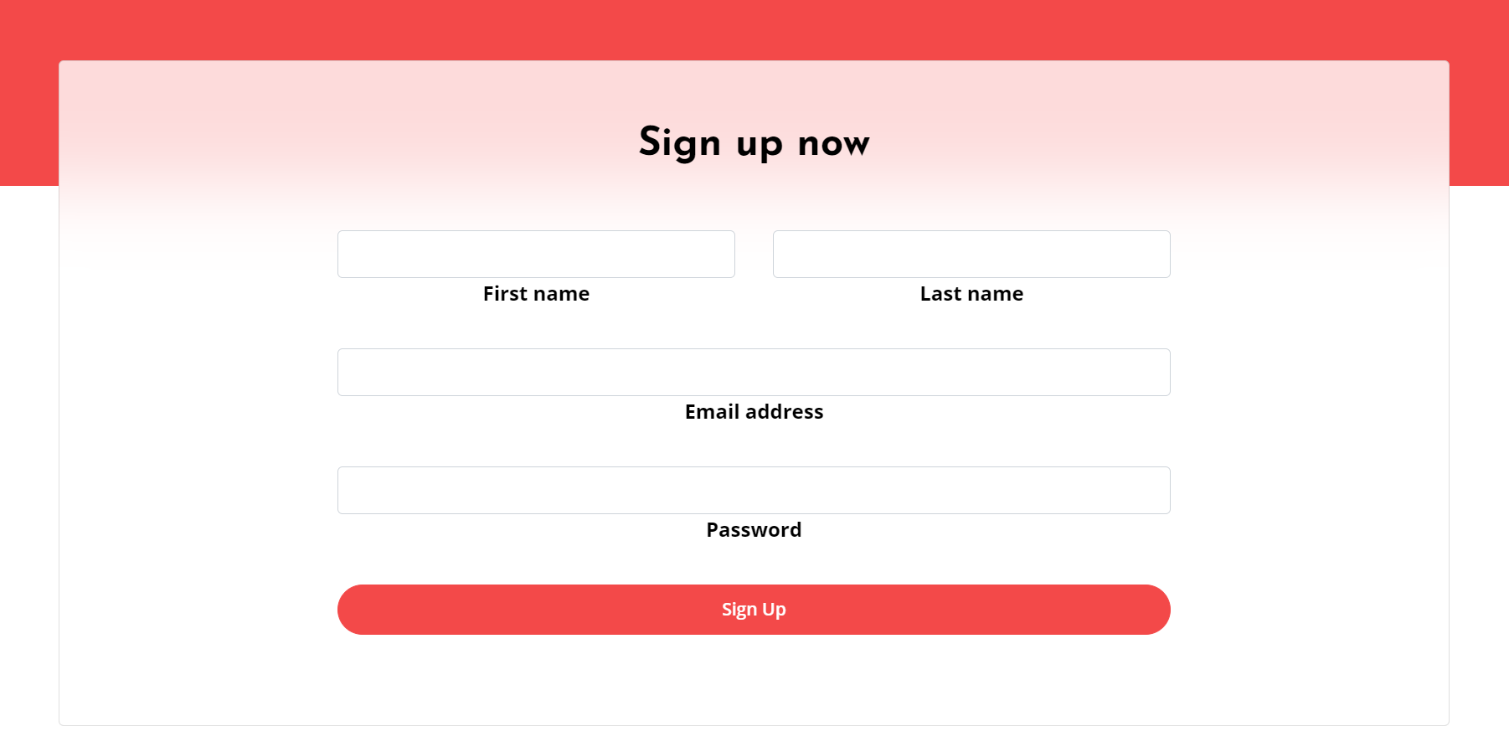
SIGN UP
Text boxes
Button

Slide 11
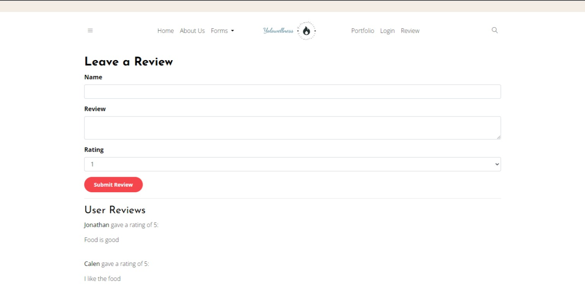
REVIEW MAKER
Text boxes
Submit
Display

Slide 12
Contribution
ADM Number | Name: | Contribution
2124207 | Periasamy Poorva Sandhiya | Front End for entire website, php for the forms, bootstrap integration, video embbedment
2020709 | Jonathan Teh | Implementing Cookies and Session, Footer page, Paypal payment
2123925 | Herald Inbha | Database for the forms,php for forms
2103103 | Caelan | About Us page

Slide 13
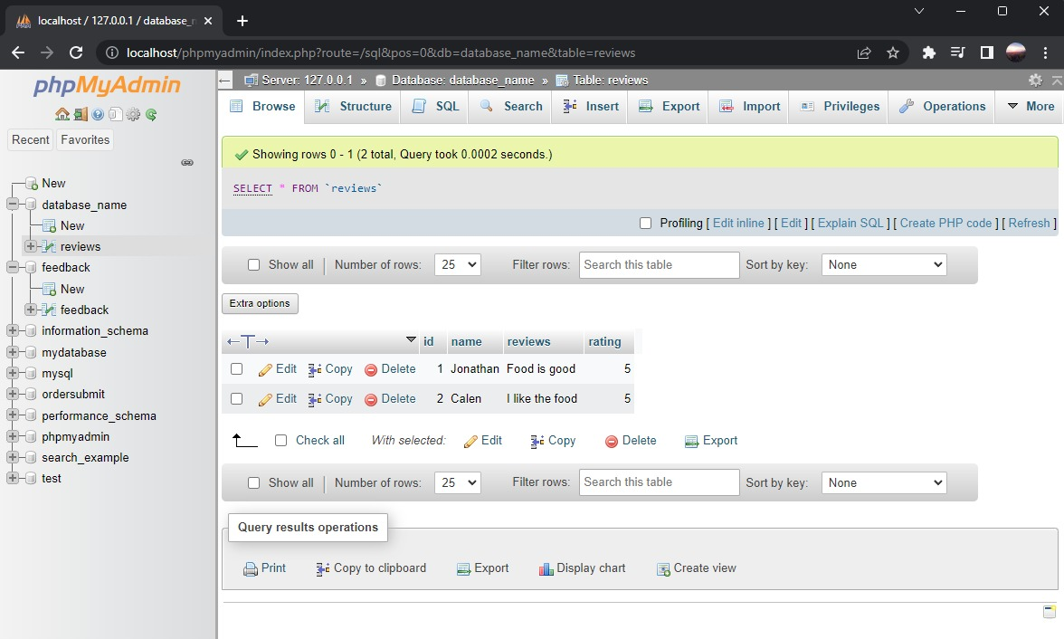
DATABASE

Slide 14
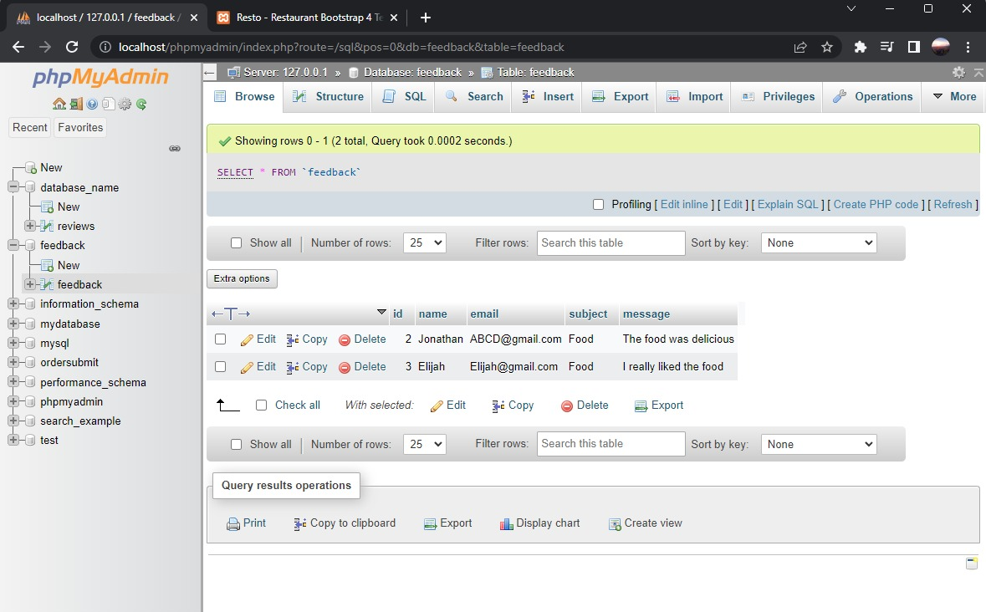
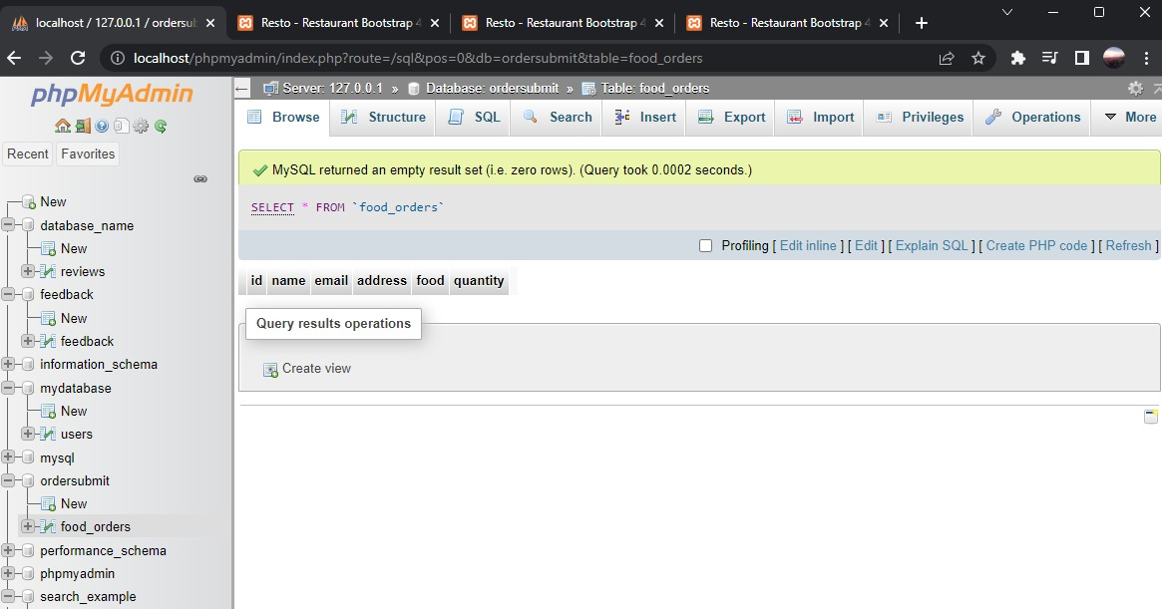

Slide 15
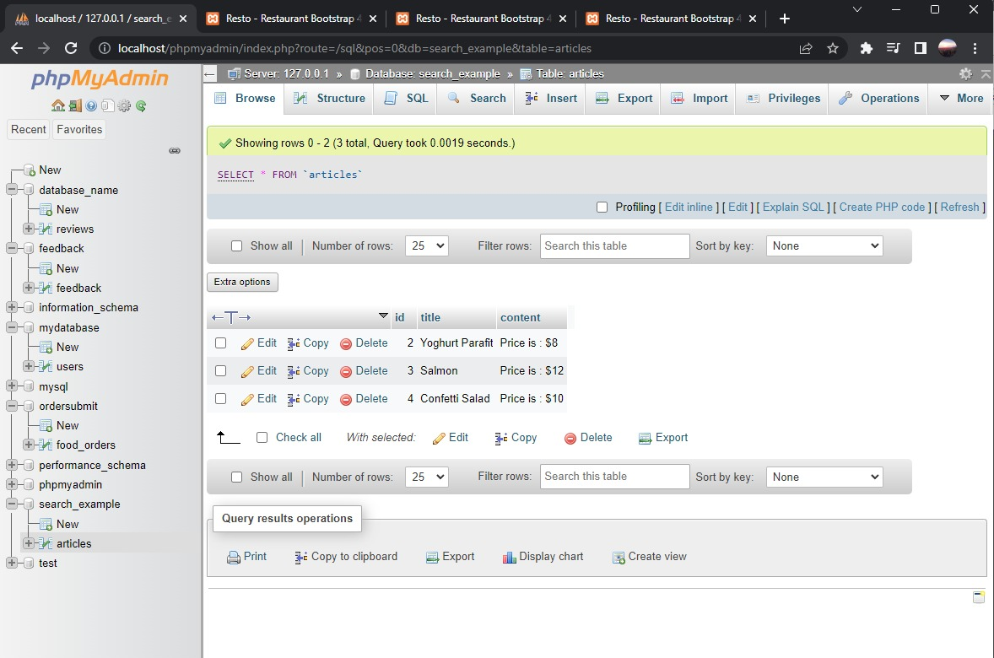

Slide 16
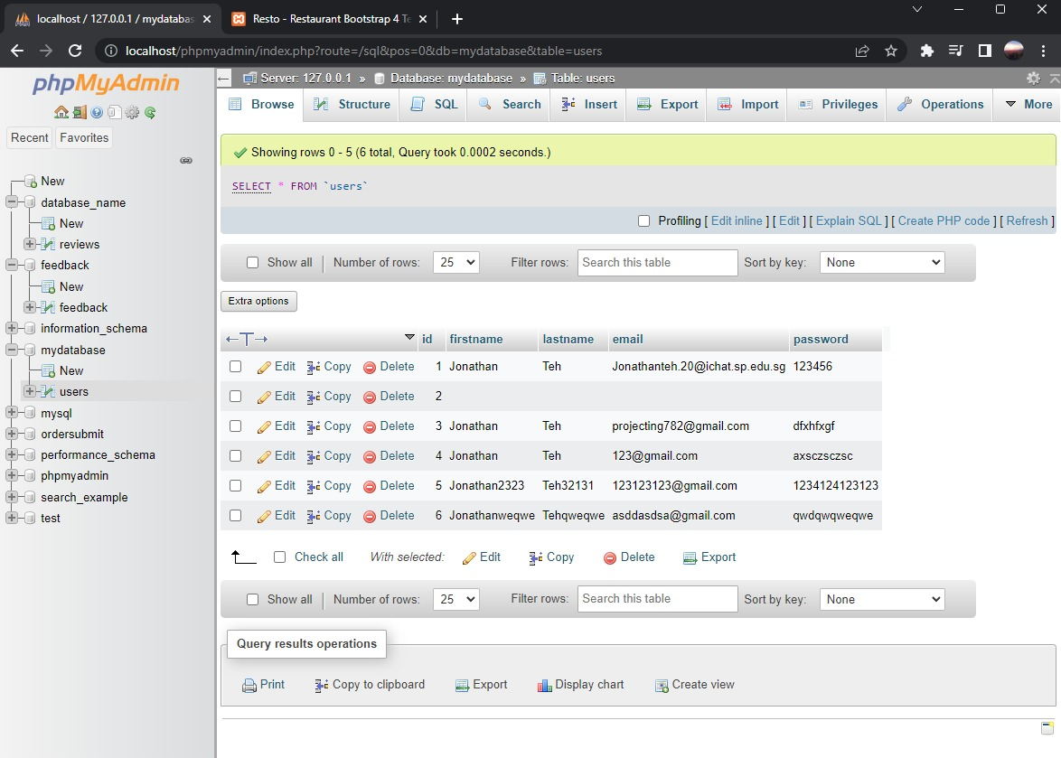

Slide 17
THANKS!

